Slide 1
DECONVOLUTION

Slide 2
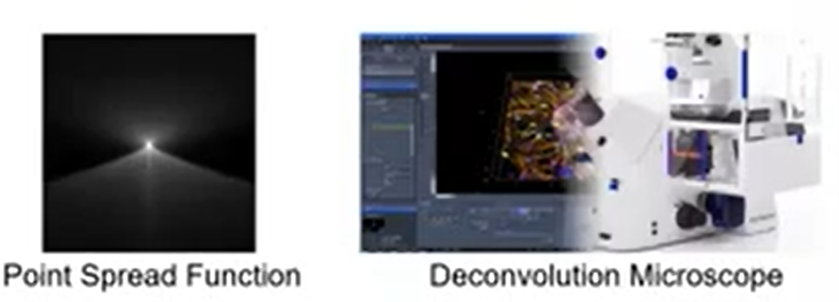
DECONVOLUTION
Deconvolution is a mathematical method, which can improve microscope images by knowledge of its optical properties.
Every microscope system is a complex combination of optic, mechanical and electronic components.
Images generated by such system suffer from certain limitations leading to undesired negative effects on image quality such as
Image blur.
Noise.
Lack of Contrast.
Lack of Resolution.

Slide 3
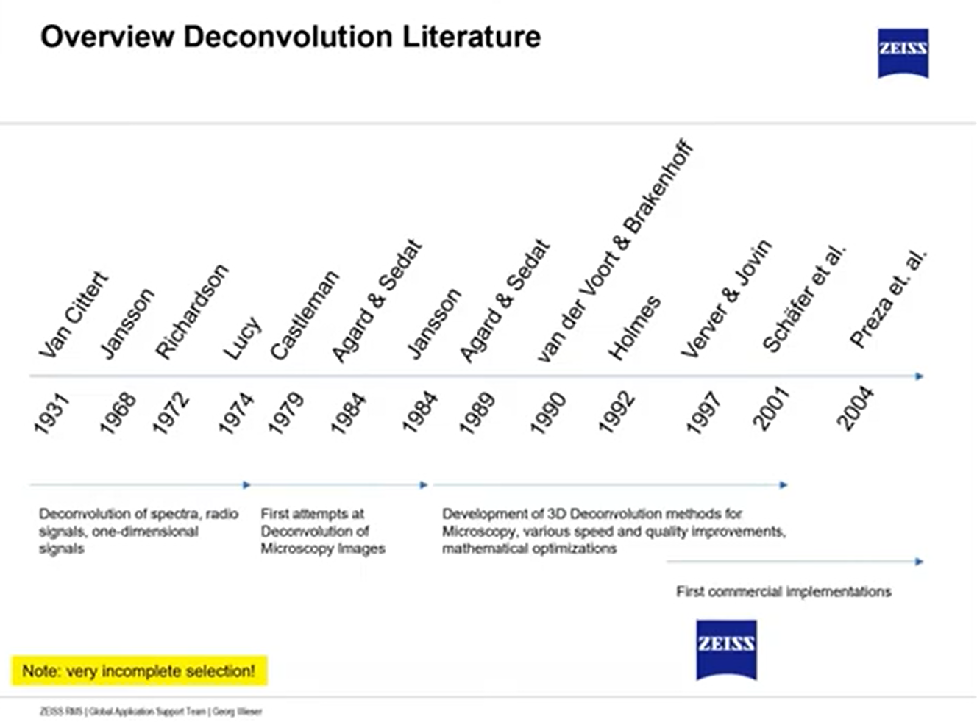
Overview of Deconvolution Literature
Quick overview history of Deconvolution.
Initially Deconvolution was a concept of improving the transmission of signal and spectral data.
Related to 80’s images with microscopy.
90’s rapidly involving field and creating 3D data wide field microscope and also improving 3D images data sets for Confocal Microscope.

Slide 4
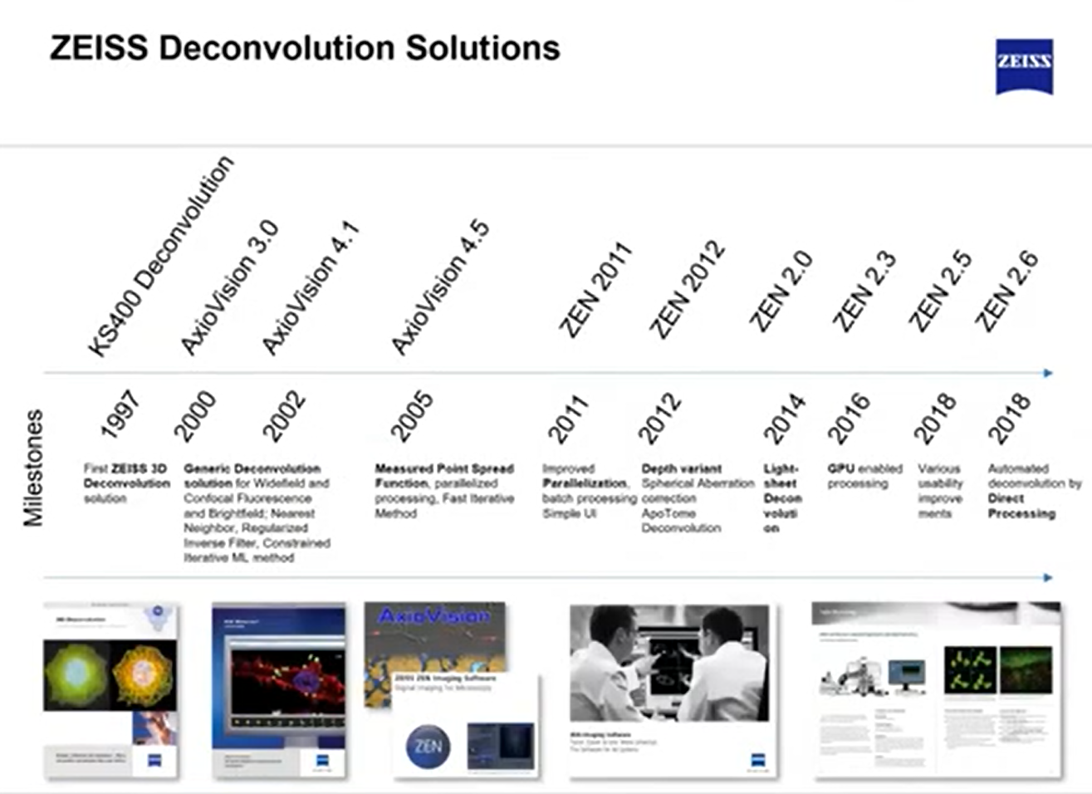
Overview of Deconvolution Literature

Slide 5
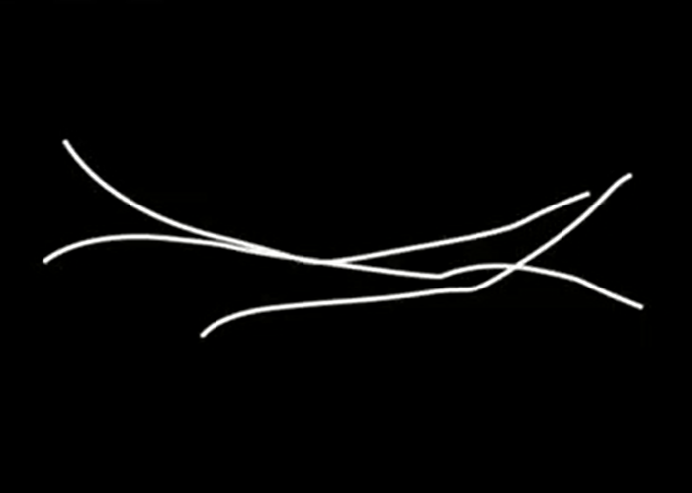
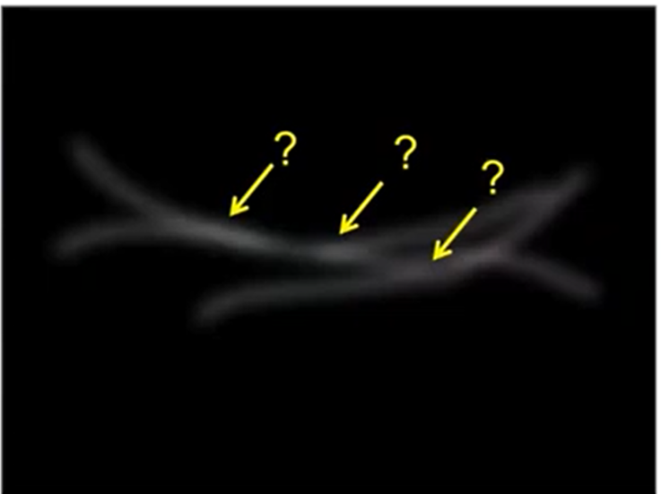
Image Generated by Microscope
Figure: Original Picture of Microtubule
Figure: Image Generated by Microscope (it contain some content some extent of blur, noise, and reduce contrast

Slide 6
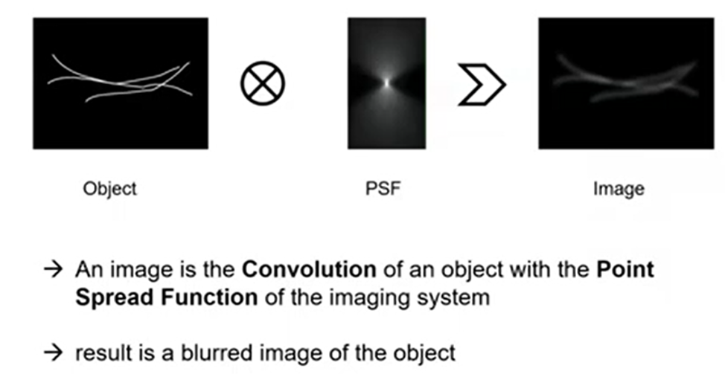
Convolution Operation OR Process of Image Formation in a Light Microscope
Process of image formation in a Light Microscope is a Convolution Operation of an object with the Point Spread Function to reconstruct the new image.

Slide 7
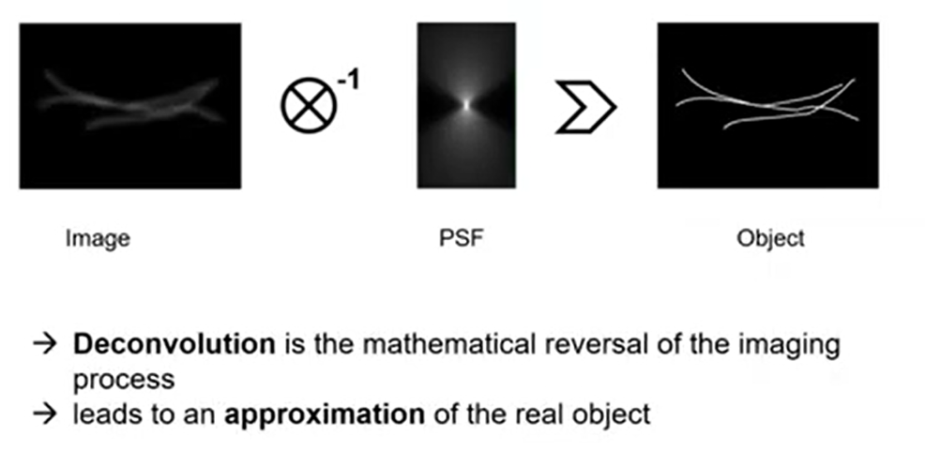
Deconvolution Operation
It is the reversal of the convolution or reversal of the image process.

Slide 8
Diffraction Limit
Diffraction Limit is the point where two Airy patterns are no longer distinguishable from each other.
The diffraction-limited resolution, often referred to as the cutoff frequency of a lens.
The limit is basically a result of diffraction processes and the wave nature of light.

Slide 9
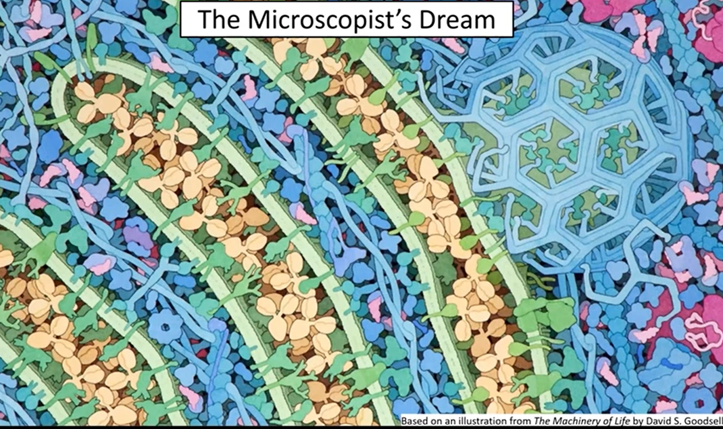

Slide 10
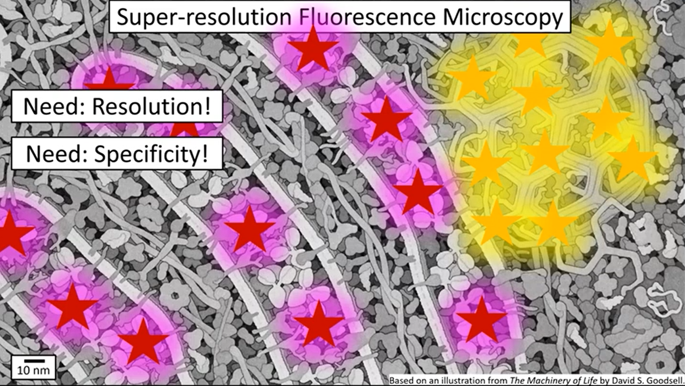

Slide 11
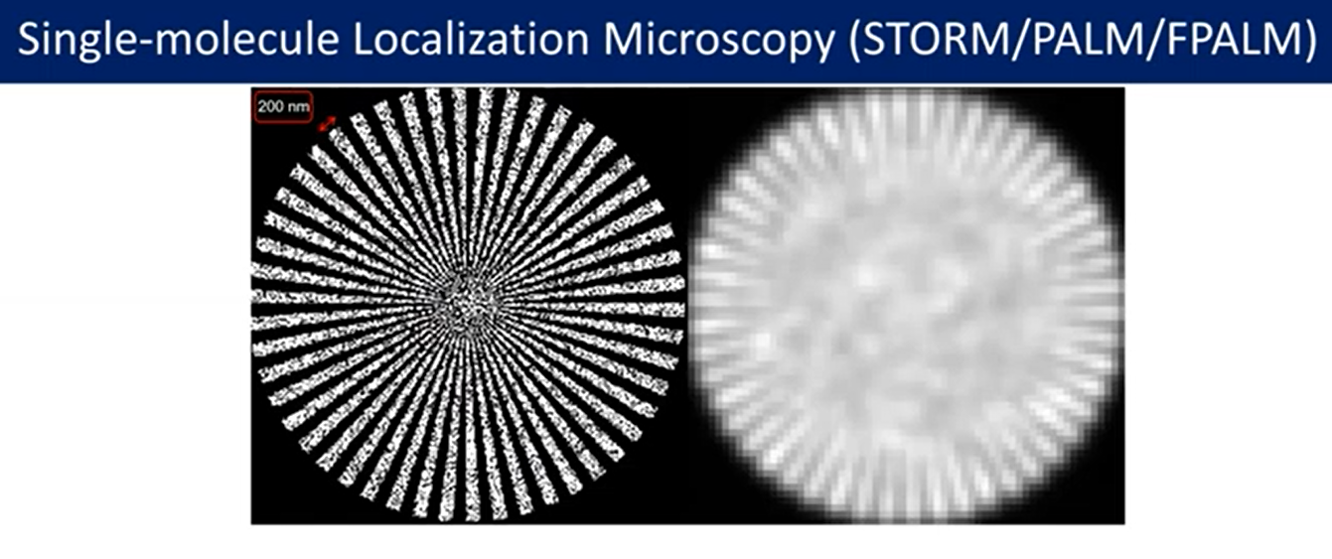

Slide 12
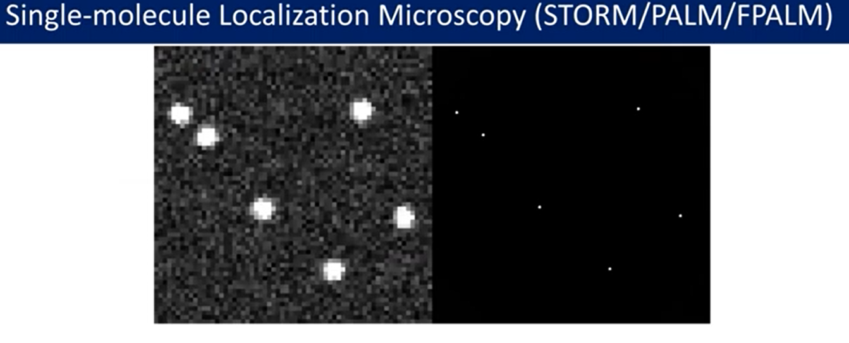

Slide 13
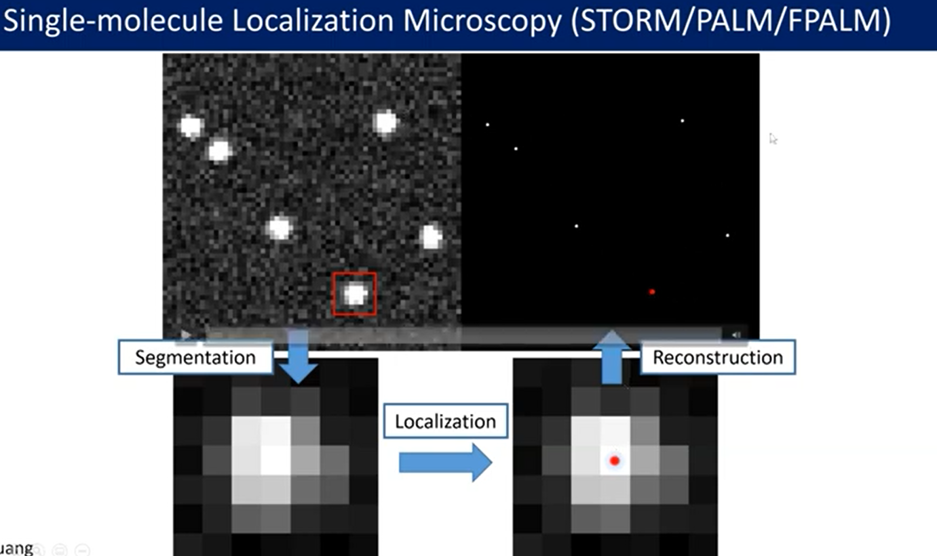

Slide 14
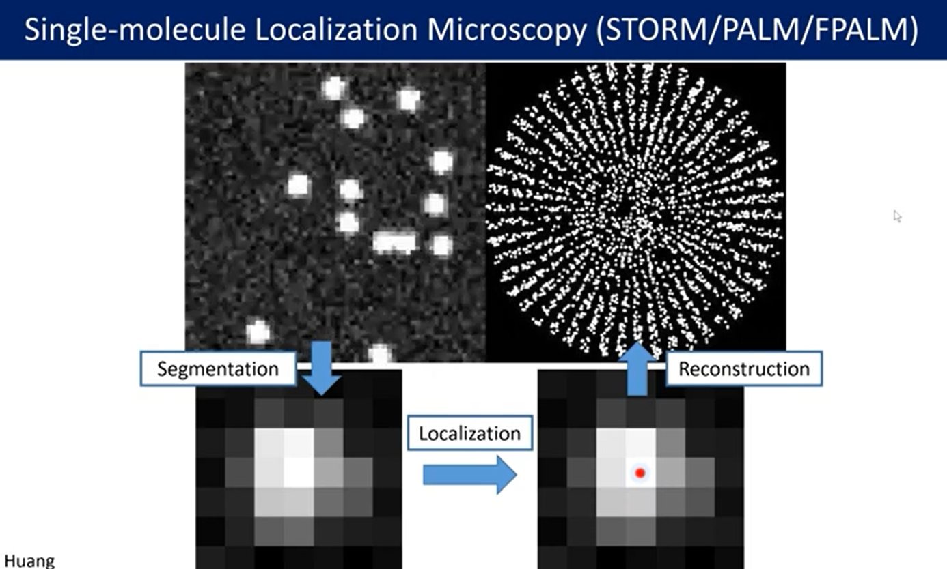

Slide 15
